Slide 1


AGON PARTNERS
INNOVATION AG
Agon Ātrium
Reimagine your admin experience.
ADMIN DASHBOARD TEMPLATE
Notes:
Great software deserves an exceptional interface. Introducing Agon Atrium, by Agon Partners Innovation A G. A new starting point for ambitious admin experiences, with a distinctive visual identity and a rich collection of components ready to make your own.
Source: actual Agon Atrium production showcase, repository snapshot 2026-09-19. Screenshots: . UI and business data are illustrative showcase fixtures. Opening artwork: AI-generated concept inspired by the user-provided great.png reference. Original Agon logo preserved. Narration is synthetic.

Slide 2
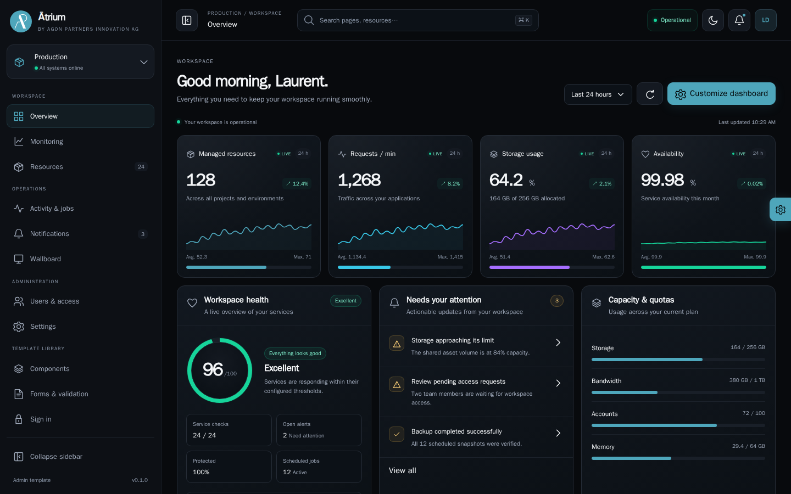
Agon Ātrium
02 / 14
The whole picture.
At a glance.
A command centre your teams can make their own.
AGON PARTNERS INNOVATION AG
SHOWCASE · SAMPLE DATA
Notes:
Give your teams a workspace that brings the essentials into focus. Metrics, service health, capacity and activity share one coherent dashboard. Configurable widgets let people organise the view around the work that matters to them.
Source: actual Agon Atrium production showcase, repository snapshot 2026-09-19. Screenshots: dashboard. UI and business data are illustrative showcase fixtures. Opening artwork: AI-generated concept inspired by the user-provided great.png reference. Original Agon logo preserved. Narration is synthetic.

Slide 3
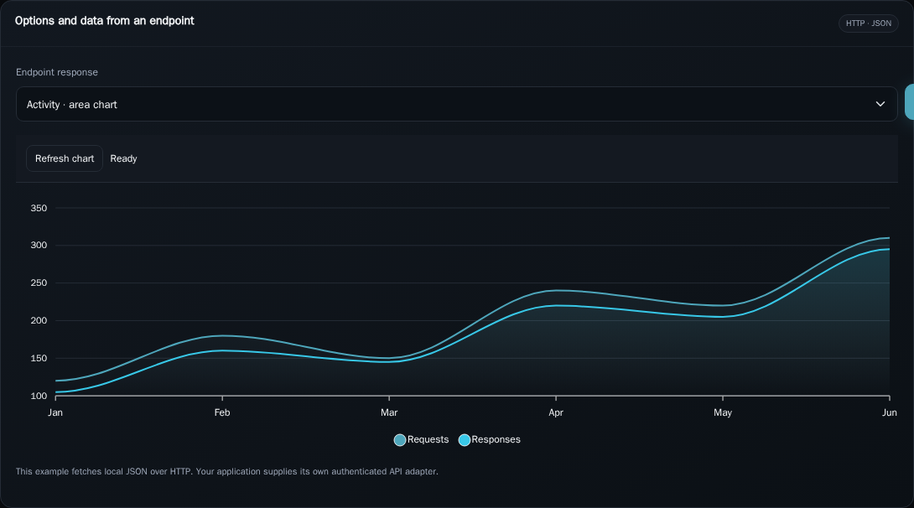
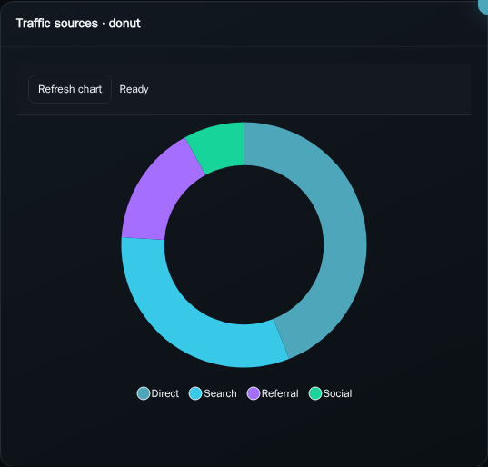
Agon Ātrium
03 / 14
Make data compelling.
Interactive charts. Your data. Your story.
AGON PARTNERS INNOVATION AG
SHOWCASE · SAMPLE DATA
Notes:
Turn information into a visual story. Atrium brings interactive area charts, columns, doughnuts and radial indicators into the same design language. Connect your own data source, switch datasets and give users a clear view of changing performance.
Source: actual Agon Atrium production showcase, repository snapshot 2026-09-19. Screenshots: chart, chart-donut. UI and business data are illustrative showcase fixtures. Opening artwork: AI-generated concept inspired by the user-provided great.png reference. Original Agon logo preserved. Narration is synthetic.

Slide 4
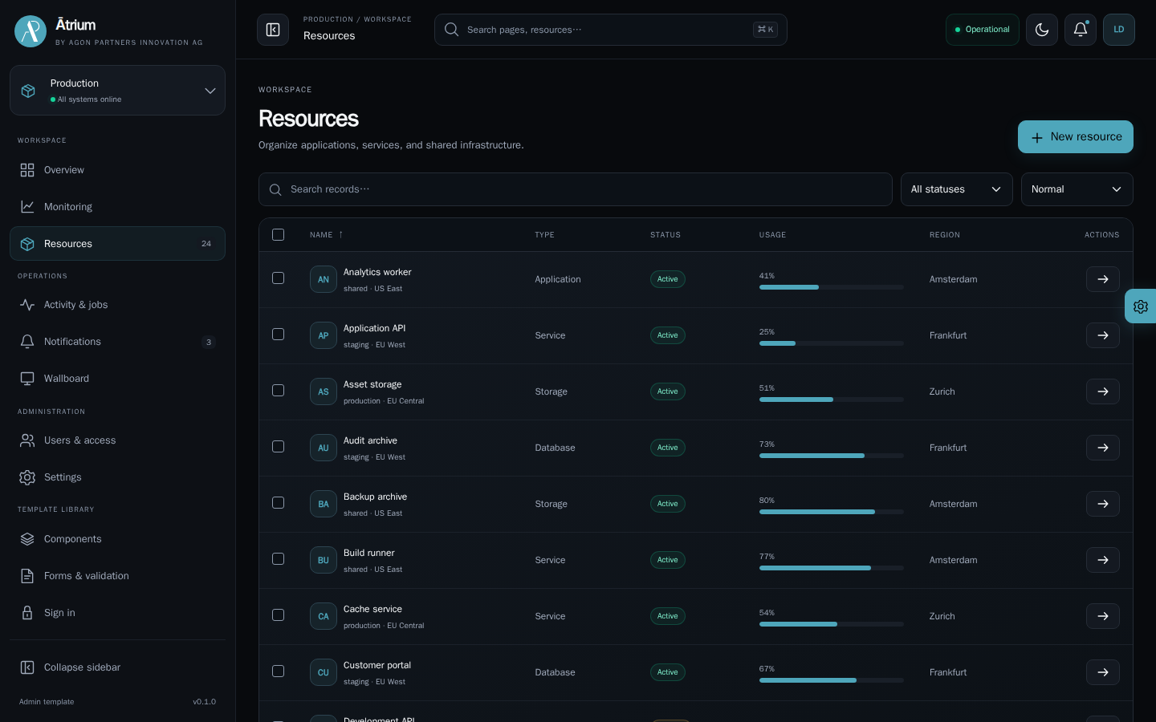
Agon Ātrium
04 / 14
Complex data.
Clear control.
Search, filter and act in a familiar workspace.
AGON PARTNERS INNOVATION AG
SHOWCASE · SAMPLE DATA
Notes:
Make daily administration feel natural. Searchable tables combine sorting, pagination, selection and contextual actions. Resource pages bring records and details together, while query state stays in the address bar so users can return to the same view.
Source: actual Agon Atrium production showcase, repository snapshot 2026-09-19. Screenshots: resources. UI and business data are illustrative showcase fixtures. Opening artwork: AI-generated concept inspired by the user-provided great.png reference. Original Agon logo preserved. Narration is synthetic.

Slide 5
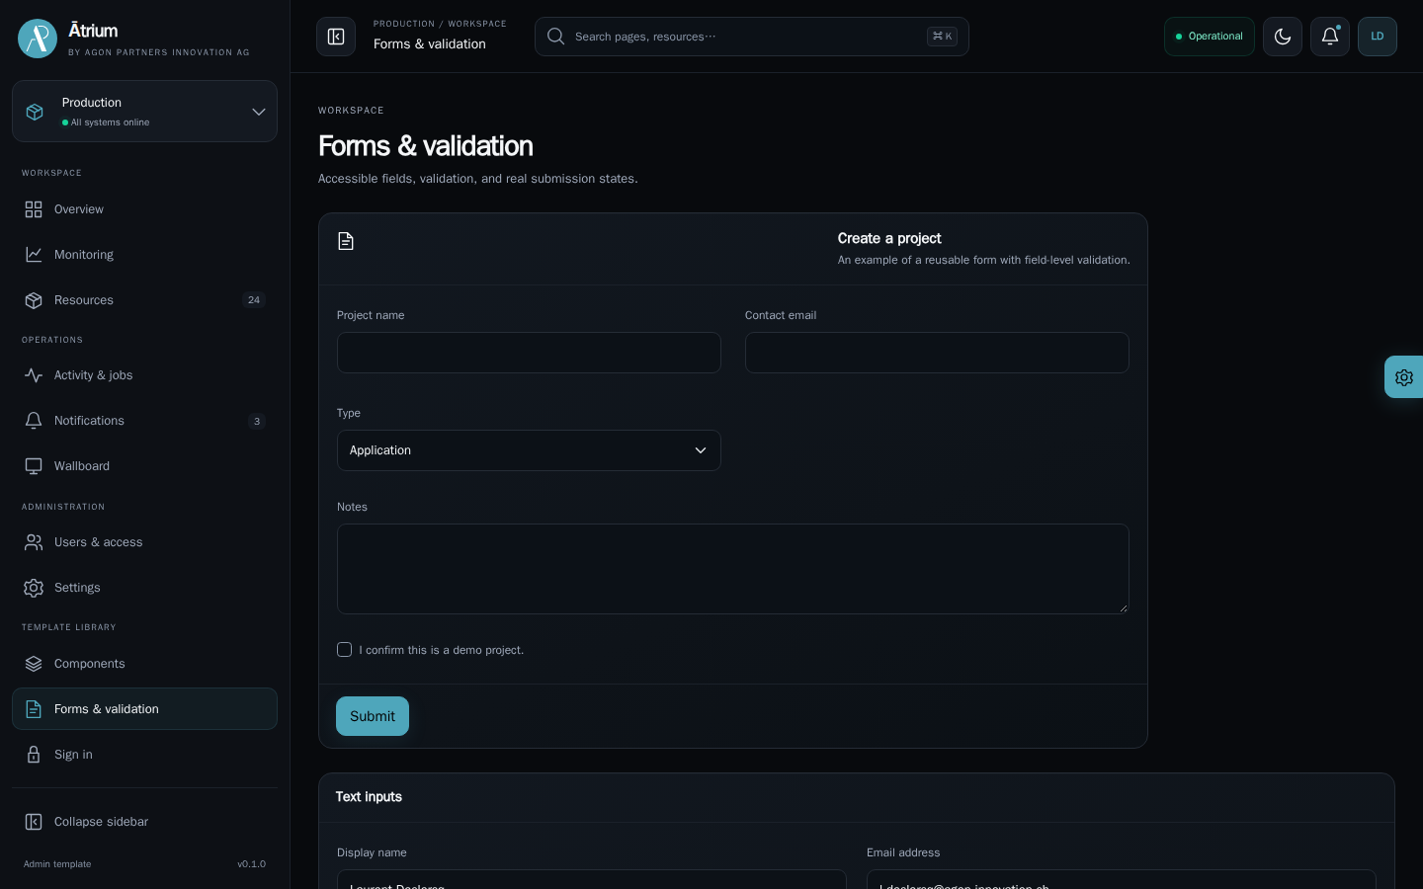
Agon Ātrium
05 / 14
Every interaction
feels considered.
Consistent forms with validation and useful feedback.
AGON PARTNERS INNOVATION AG
SHOWCASE · SAMPLE DATA
Notes:
Carry the experience through every input. Forms, validation messages, switches and selection controls work within the same visual system. Clear feedback guides users through their next action and gives your application a consistent, professional finish.
Source: actual Agon Atrium production showcase, repository snapshot 2026-09-19. Screenshots: forms. UI and business data are illustrative showcase fixtures. Opening artwork: AI-generated concept inspired by the user-provided great.png reference. Original Agon logo preserved. Narration is synthetic.

Slide 6
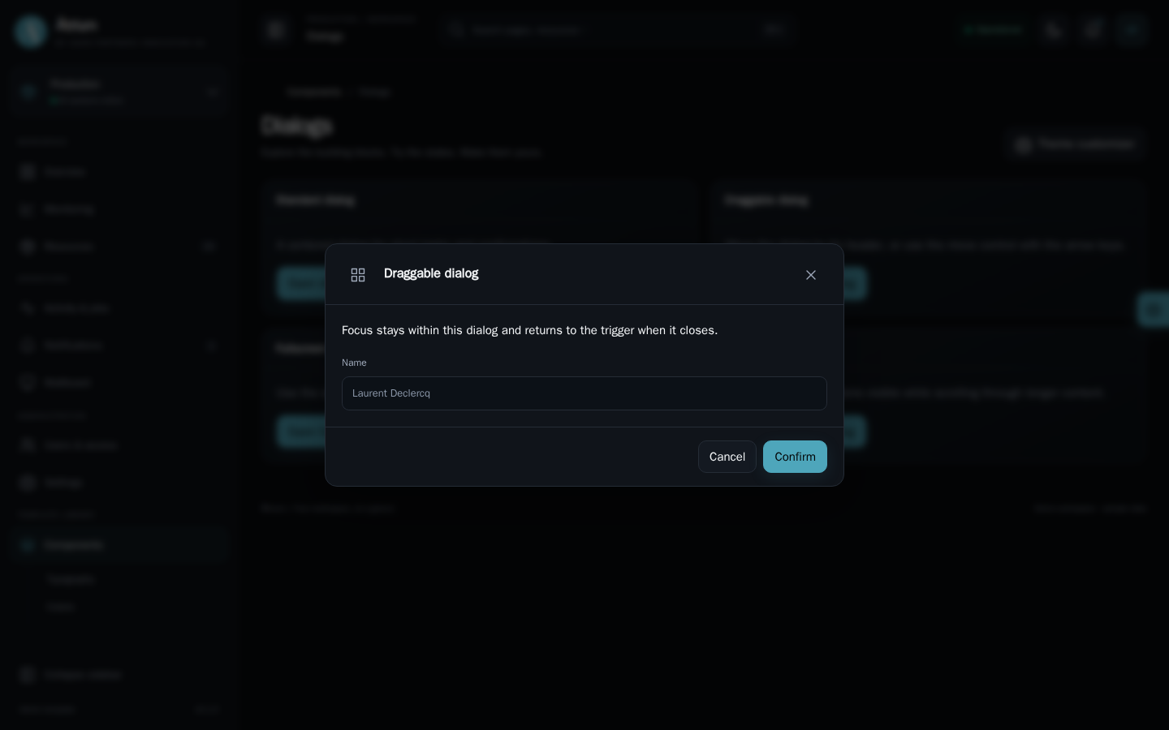
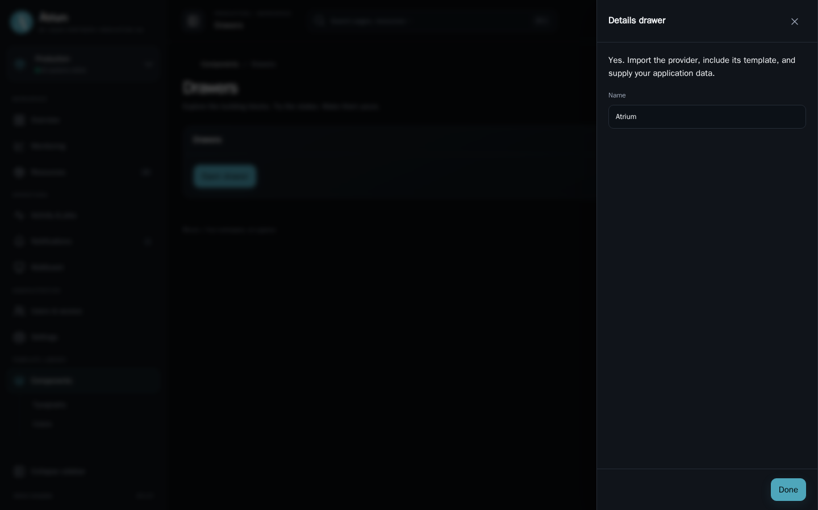
Agon Ātrium
06 / 14
Keep the task in focus.
Dialogs and drawers that fit the workflow.
AGON PARTNERS INNOVATION AG
SHOWCASE · SAMPLE DATA
Notes:
Open the right workspace at the right moment. Standard, draggable and fullscreen dialogs support focused tasks. Side drawers keep supporting information close, with keyboard interaction and focus management built into the shared components.
Source: actual Agon Atrium production showcase, repository snapshot 2026-09-19. Screenshots: dialog, drawer. UI and business data are illustrative showcase fixtures. Opening artwork: AI-generated concept inspired by the user-provided great.png reference. Original Agon logo preserved. Narration is synthetic.

Slide 7
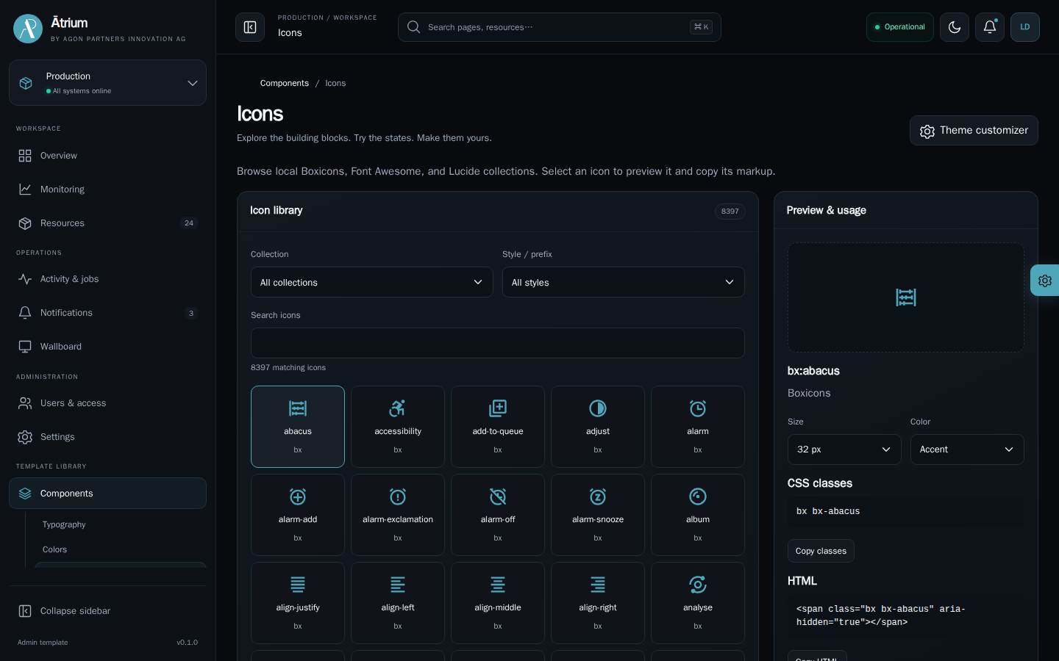
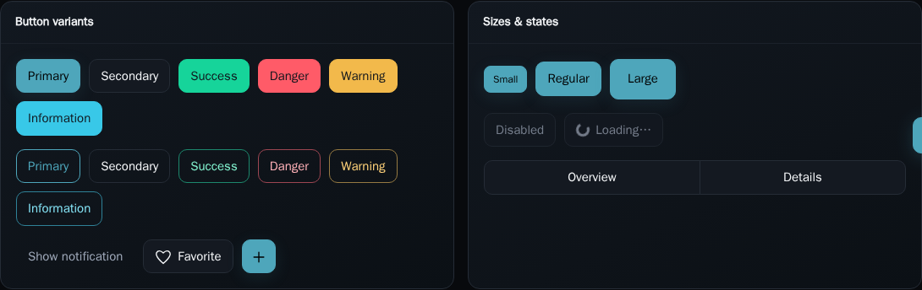
Agon Ātrium
07 / 14
A distinctive
design language.
Rich component choices. One coherent identity.
AGON PARTNERS INNOVATION AG
SHOWCASE · SAMPLE DATA
Notes:
Build a recognisable product across every screen. Explore a searchable icon gallery, button styles, badges, navigation patterns and feedback components. The showcase makes the options tangible, so your team can compose the experience with confidence.
Source: actual Agon Atrium production showcase, repository snapshot 2026-09-19. Screenshots: icons, buttons. UI and business data are illustrative showcase fixtures. Opening artwork: AI-generated concept inspired by the user-provided great.png reference. Original Agon logo preserved. Narration is synthetic.

Slide 8
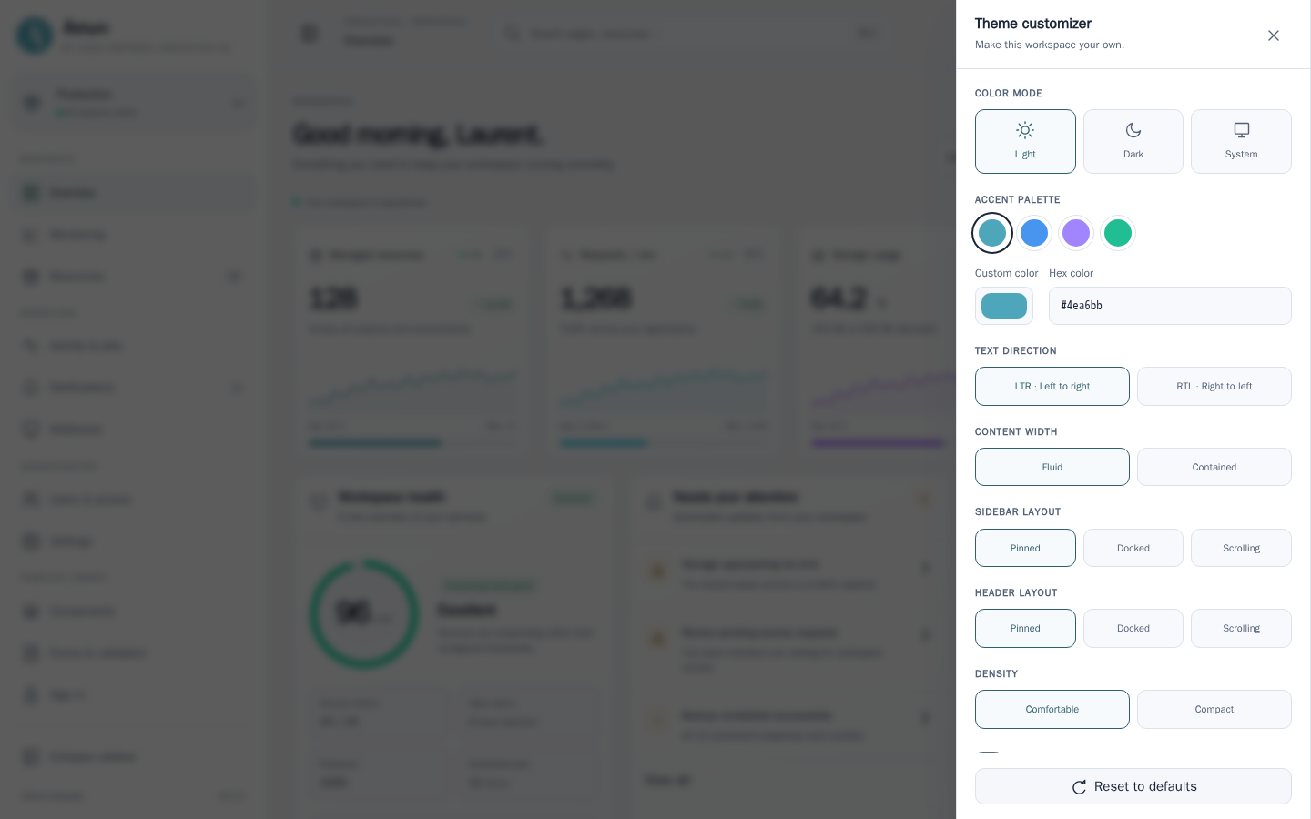
Agon Ātrium
08 / 14
Your brand.
Your workspace.
Light or dark. Flexible layouts. Personal accents.
AGON PARTNERS INNOVATION AG
SHOWCASE · SAMPLE DATA
Notes:
Make Atrium unmistakably yours. Switch between light and dark, choose your accent colour and adapt the navigation layout. Density, direction and saved preferences help the workspace fit different teams, while the shared theme keeps the interface coherent.
Source: actual Agon Atrium production showcase, repository snapshot 2026-09-19. Screenshots: theme. UI and business data are illustrative showcase fixtures. Opening artwork: AI-generated concept inspired by the user-provided great.png reference. Original Agon logo preserved. Narration is synthetic.

Slide 9
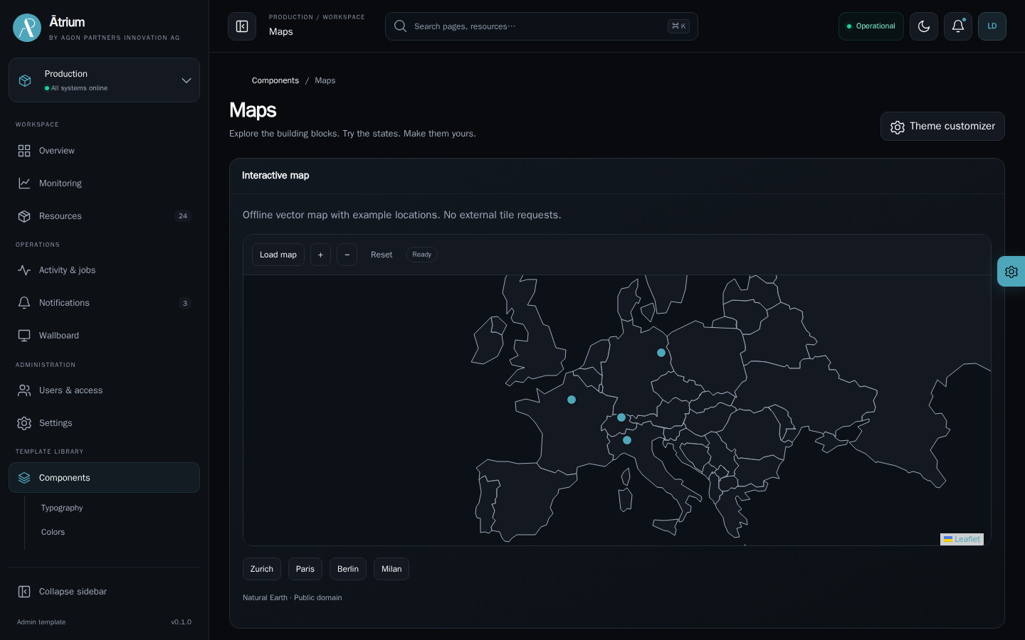
Agon Ātrium
09 / 14
Add a sense
of place.
Interactive maps within the same workspace.
AGON PARTNERS INNOVATION AG
SHOWCASE · SAMPLE DATA
Notes:
Bring geography into the experience with interactive maps, markers and location details. The map component fits naturally into the dashboard, letting your application connect places with the records and services that matter to your users.
Source: actual Agon Atrium production showcase, repository snapshot 2026-09-19. Screenshots: map. UI and business data are illustrative showcase fixtures. Opening artwork: AI-generated concept inspired by the user-provided great.png reference. Original Agon logo preserved. Narration is synthetic.

Slide 10
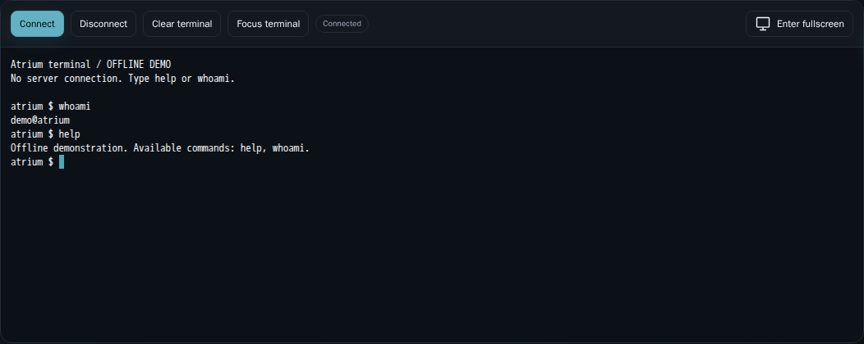
Agon Ātrium
10 / 14
The terminal. Inside your app.
An xterm interface ready for your authorised gateway.
AGON PARTNERS INNOVATION AG
SHOWCASE · SAMPLE DATA
Notes:
Put operational tools where the work happens. The xterm terminal offers keyboard input, connection controls, responsive sizing and fullscreen viewing. Connect it through your application's authorised gateway. Here, the offline showcase session demonstrates the interface without contacting a server.
Source: actual Agon Atrium production showcase, repository snapshot 2026-09-19. Screenshots: terminal. UI and business data are illustrative showcase fixtures. Opening artwork: AI-generated concept inspired by the user-provided great.png reference. Original Agon logo preserved. Narration is synthetic.

Slide 11
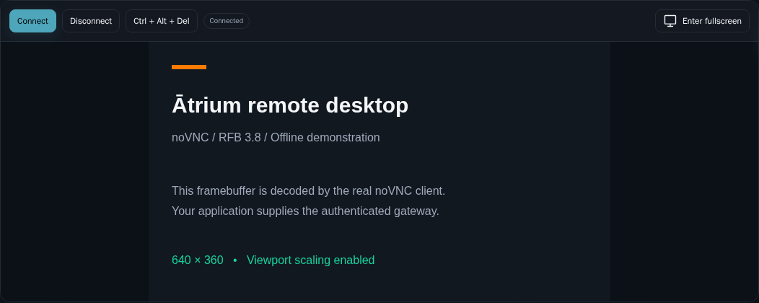
Agon Ātrium
11 / 14
Remote desktops. One workspace.
A noVNC viewer with connection and fullscreen controls.
AGON PARTNERS INNOVATION AG
SHOWCASE · SAMPLE DATA
Notes:
Extend the workspace to remote desktops. Atrium integrates the no V N C viewer with connection status, viewport scaling and fullscreen controls. The showcase uses the real R F B decoder with a local demonstration desktop. Your application supplies the authenticated remote session.
Source: actual Agon Atrium production showcase, repository snapshot 2026-09-19. Screenshots: vnc. UI and business data are illustrative showcase fixtures. Opening artwork: AI-generated concept inspired by the user-provided great.png reference. Original Agon logo preserved. Narration is synthetic.

Slide 12
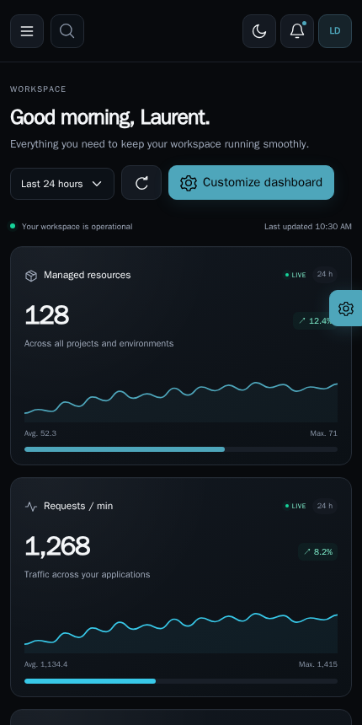
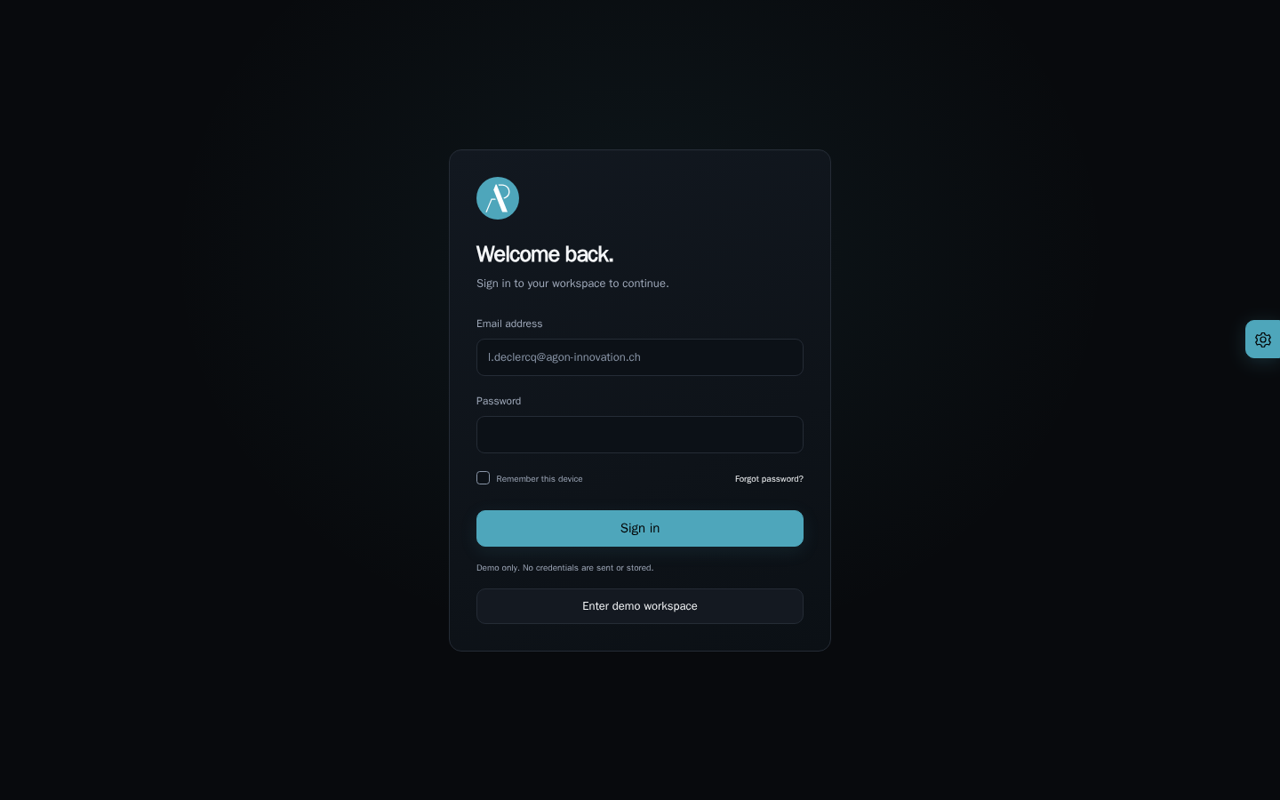
Agon Ātrium
12 / 14
A consistent
experience everywhere.
Responsive layouts and localised interfaces.
AGON PARTNERS INNOVATION AG
SHOWCASE · SAMPLE DATA
Notes:
Keep your product recognisable as the screen changes. Responsive navigation and mobile layouts carry the experience beyond the desktop. English, German, French and Italian interface dictionaries give teams a multilingual starting point, alongside coordinated authentication page templates.
Source: actual Agon Atrium production showcase, repository snapshot 2026-09-19. Screenshots: mobile, login. UI and business data are illustrative showcase fixtures. Opening artwork: AI-generated concept inspired by the user-provided great.png reference. Original Agon logo preserved. Narration is synthetic.

Slide 13
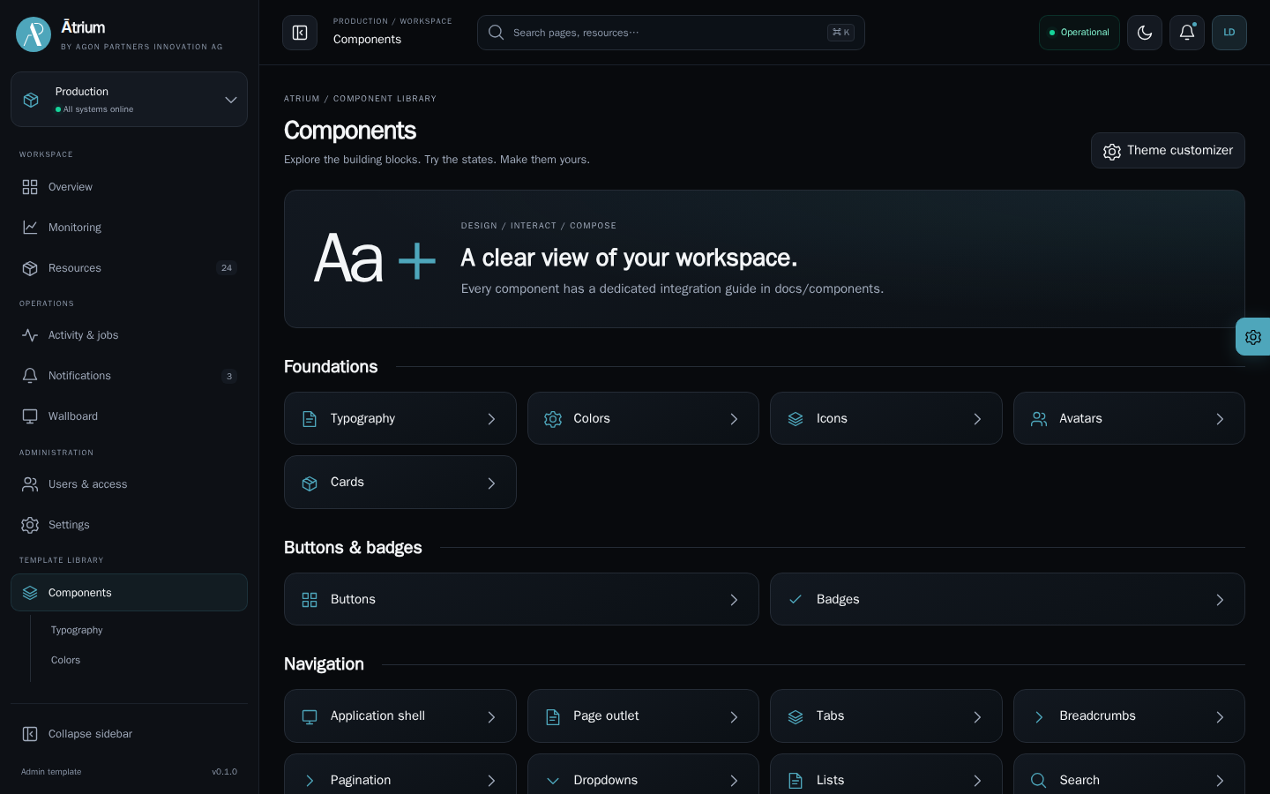
Agon Ātrium
13 / 14
A head start
for your next product.
Start with a template.
Make it yours.
Connect your services.
AGON PARTNERS INNOVATION AG
SHOWCASE · SAMPLE DATA
Notes:
Start with the lean starter or the complete showcase. Reuse the shared components, apply your branding and connect your services through application-owned adapters. With Alpine and Bootstrap styling underneath, Atrium gives you a clear integration path and keeps your business logic in your hands.
Source: actual Agon Atrium production showcase, repository snapshot 2026-09-19. Screenshots: catalogue. UI and business data are illustrative showcase fixtures. Opening artwork: AI-generated concept inspired by the user-provided great.png reference. Original Agon logo preserved. Narration is synthetic.

Slide 14
AGON PARTNERS
INNOVATION AG
Your next admin
starts here.
Agon Ātrium
By Agon Partners Innovation AG
Notes:
Reimagine what an admin interface can feel like. Give your teams clarity. Give your product a distinctive identity. And give your next application a stronger starting point. Explore Agon Atrium, by Agon Partners Innovation A G.
Source: actual Agon Atrium production showcase, repository snapshot 2026-09-19. Screenshots: . UI and business data are illustrative showcase fixtures. Opening artwork: AI-generated concept inspired by the user-provided great.png reference. Original Agon logo preserved. Narration is synthetic.

